Slide 1
HR Appointment Requests in ATLAS

Slide 2
SESE/SIB Human Resources Team | Title
Cassie Kenton | Assistant Director of Human Resources
Jessica Seipp Denise Madden | Senior HR Generalist HR Associate
John Fogle | HR Generalist
SESE HR SIB HR | SESE-hr@illinois.edu Sib-hr@illinois.edu
College LAS HR | LASCollegeHiring@illinois.edu

Slide 3
SESE HR -
Send all HR requests to SESE-hr@illinois.edu and a team of HR professionals who monitor this inbox will assist with everything from Recruiting, Posting Vacancies, Hiring, ISSS Services, FMLA/Leave Requests, Retire/Rehire through Separation.
Student appointments entered in https://my.atlas.illinois.edu/appointments/
RA appointments entered by faculty
TA appointments entered by department appointee

Slide 4
Training Outline
This training guide will cover the following topics:
Logging into My.Atlas portal
Requesting a NEW employee
Requesting a CHANGE on current employee
What is needed in the appointment request
Adding/Requesting a Proxy
Current Pay Scales
Reminders

Slide 5
My.Atlas – Logging In
My.Atlas Portal
Log in at https://my.atlas.Illinois.edu/

Slide 6
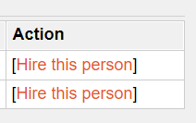
Requesting NEW Employee
New Employee – Create New Job
Search by First/Last Name, UIN, or NetID
No Results? Click on the Create New Appointment Button
Results?! Click on “Hire this person” at the far right of the screen.

Slide 7
IMPORTANT REMINDER!
**DO NOT allow any person to begin work without clearance from HR.
-New employees may need I-9, background checks, or other required verification before cleared for work.

Slide 8
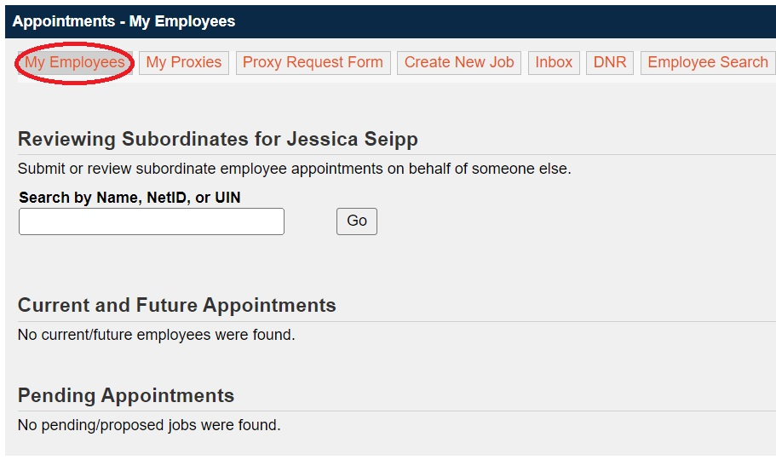
Changes for CURRENT Employee
Current Employee – Go to My Employees
Your list of employees will be sorted by Current/Future appointments and Pending appointments.

Slide 9
Changes for CURRENT Employee
Current and Future Appointments will have 3 available action items:
Change – Used when employee resigns early, updating pay rate, or changing CFOP.
Reappoint – Used to extend a current job.
Do Not Reappoint – Used for cleanup efforts of a supervisor’s employee list.
If you need to add a secondary job for a current employee
Follow the “Create New Job” steps to add the new job.

Slide 10
What information is needed?
Here is what you should include when submitting a new appointment or a reappointment:
-What will they be doing?*
-How many hours per week will they work or what is their FTE?*
-How much would you like to pay?*
-What funding will be used?
-What dates will they be appointed?*
-Where will this work be performed?
-What is the hiring unit?
-What type of appointment is being requested?
-If you cannot select the option you need, please reach out to LAS HR.

Slide 11
What information is needed?
If you are hiring an Academic Hourly, Academic Professional, or a Post Doc a CV or resume, transcripts or degree conferral letters are requested.
Processing times may be quicker if these documents are already uploaded or requested. Please use the notes section to indicate if these documents have been requested.

Slide 12
What information is needed?
Remote Work Information – REQUIRED!
This question must be answered in order to submit your appointment.
Response options are: No, Yes, Hybrid, or Unsure
No – Employee works onsite
Yes – Employee will rarely, if ever, come to campus. This selection will prompt further information.
Within IL – No further action required.
Outside IL – Please indicate what state the employee will be working from so HR can complete necessary tax forms.
Outside US – CONTACT HR PRIOR TO ALLOWING ANY WORK PERFORMED OUTSIDE US.
Hybrid – Employee will work both remote and onsite.
Unsure – Please follow up with the employee or discuss work location options that are available for your appointment. Discuss with LAS HR before moving forward!

Slide 13
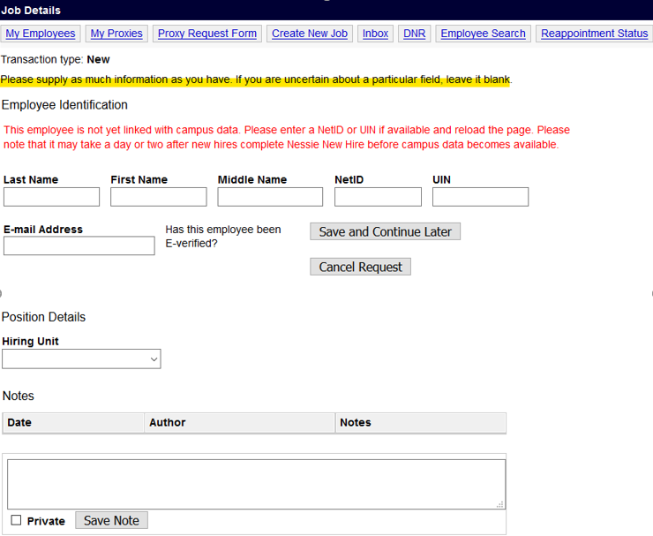
What information is needed?
Don’t know what to put in a particular field? Enter to the best of your ability but use the NOTES section to explain. HR will be able to correct the information, or we will reach out to you for further information if needed.
NOTES ARE EVERYTHING!!

Slide 14
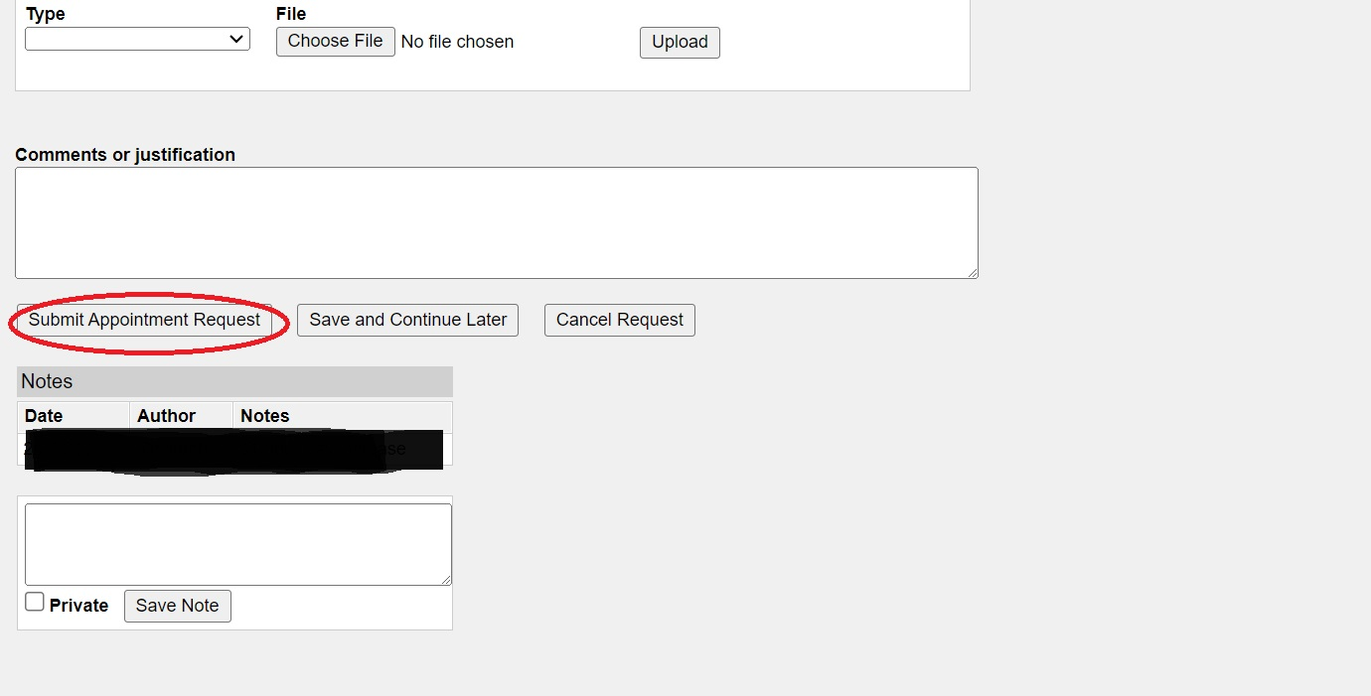
How to Submit
Once you have completed all the required information, click “Submit Appointment Request”.

Slide 15
How to Submit
If you do not see the orange statement below, please double check that all the required fields have been completed. If you still are unable to submit, please contact your HR team for assistance.
Once the appointment is submitted the HR team will then work to process and finalize. Employees should receive a Notification of Appointment when their appointment has finalized.

Slide 16
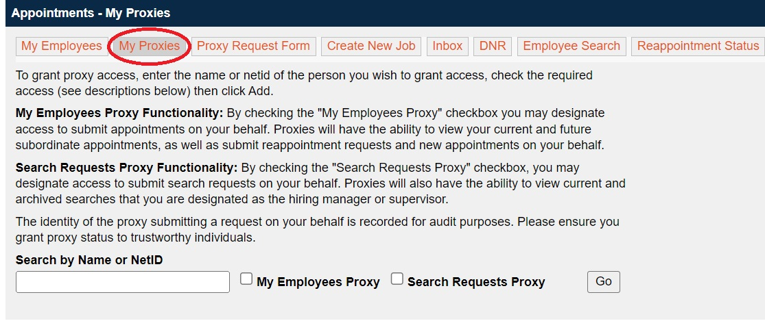
How to Add a Proxy
Proxy status allows another user to act on your behalf.
-Search by Name or NetID and hit Go
-The name will appear below and X to cancel at any time.

Slide 17
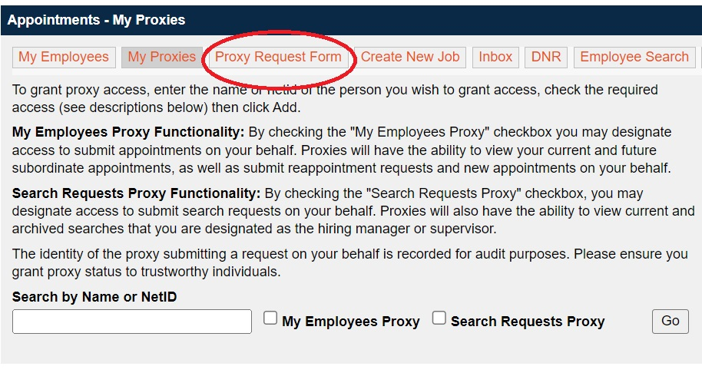
How to Add a Proxy
An employee can request access to be a proxy.
-Proxy Request Form will pop open, enter the NetID of the person you wish to proxy for. That person will have to approve your request.

Slide 18
Pay Scales
All Graduate Assistants – Either per campus or unit specific
Undergraduate rates – Dependent on job classification
Group | Classification | Range | Typical Duties
Group A | Entry level/unskilled | $14.00-$15.15/hour | Work requires no prior education or experience.
Group B | Semi-Skilled | $14.00-$15.95/hour | Work requires some experience or education
Group C | Technical | $14.00-$18.00/hour | Work requiring prior experience or education
Group D | Paraprofessional/professional | $14.00-$21.50/hour | Work requiring advanced skills specific to field employed in.

Slide 19
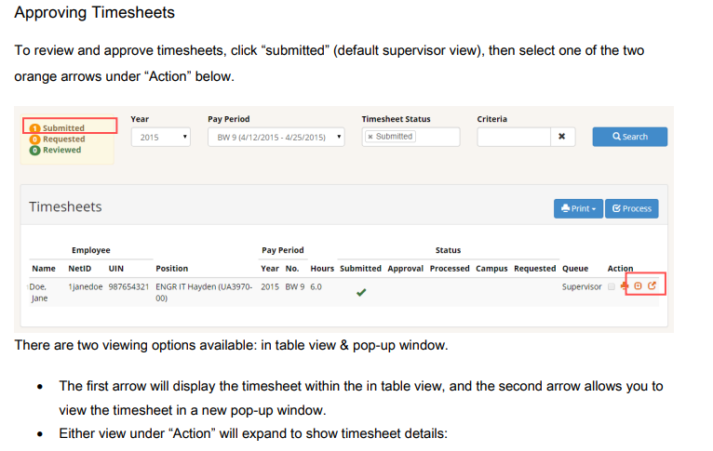
TimeTracker
Supervisors will go to my.atlas.Illinois.edu/timetracker and log in with your NetID and Password.

Slide 20
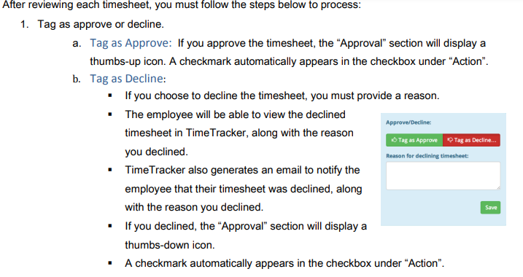
TimeTracker

Slide 21
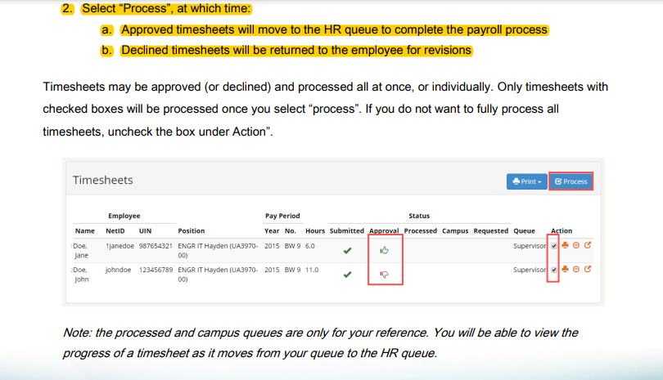
TimeTracker

Slide 22
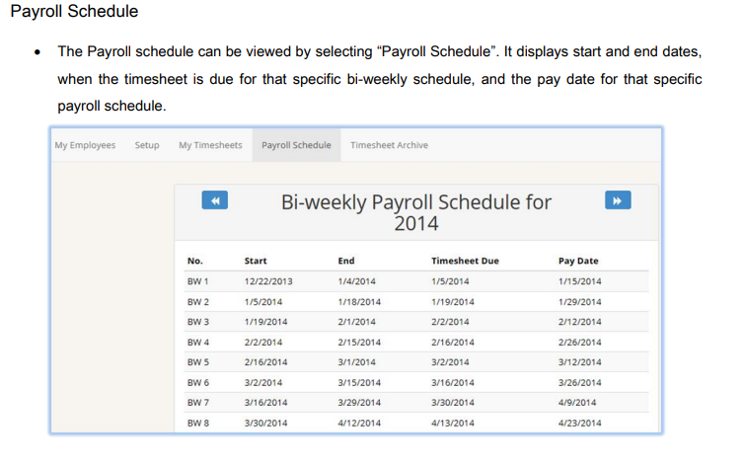
TimeTracker

Slide 23
IMPORTANT REMINDER!
**DO NOT allow any person to begin work without clearance from HR.
-New employees may need I-9, background checks, or other required verification before cleared for work.

Slide 24
Questions?
If you have any questions, would like one-on-one assistance, or would like to chat with our HR staff, you can email SIB-HR@illinois.edu or you may stop by Room 286, but please know we are working a hybrid schedule.
We look forward to continuing to serve our students, faculty, and staff!
Thank you!

